Slide 1
Bike Sharing Demand Prediction
Capstone Project - 2
By Prathik Mane

Slide 2
Problem Statement
Currently Rental bikes are introduced in many urban cities for the enhancement of mobility comfort. It is important to make the rental bike available and accessible to the public at the right time as it lessens the waiting time. Eventually, providing the city with a stable supply of rental bikes becomes a major concern. The crucial part is the prediction of bike count required at each hour for the stable supply of rental bikes.
The objective of this project is to predict bike rental demand based on the prevailing weather conditions, time of day and other factors

Slide 3
Data Description
This dataset contains 8760 rows and 14 columns.
Date: Date in DD/MM/YYYY format
Hour: Hour of the day (0-23)
Temperature: Temperature of the day in Celsius
Humidity: Humidity measure(relative)
Windspeed: Windspeed measure in m/s
Visibility: Visibility measure
Dew Point Temperature: Dew Point Temperature Measure in Celsius
Solar Radiation: Solar Radiation Measure
Rainfall: Rainfall in mm
Snowfall: Snowfall measure
Seasons: 1 = spring, 2 = summer, 3 = fall, 4 = winter
Holiday: Whether a holiday or not
Functional Day: Whether a functional day or not i.e., day is neither a weekend nor holiday
Rented bike count: This is dependent variable which we need to predict

Slide 4
Data Cleaning and Manipulation
Given dataset has zero duplicates
Also, dataset has no missing values
In this dataset, date column was split into year, month and day of the week

Slide 5
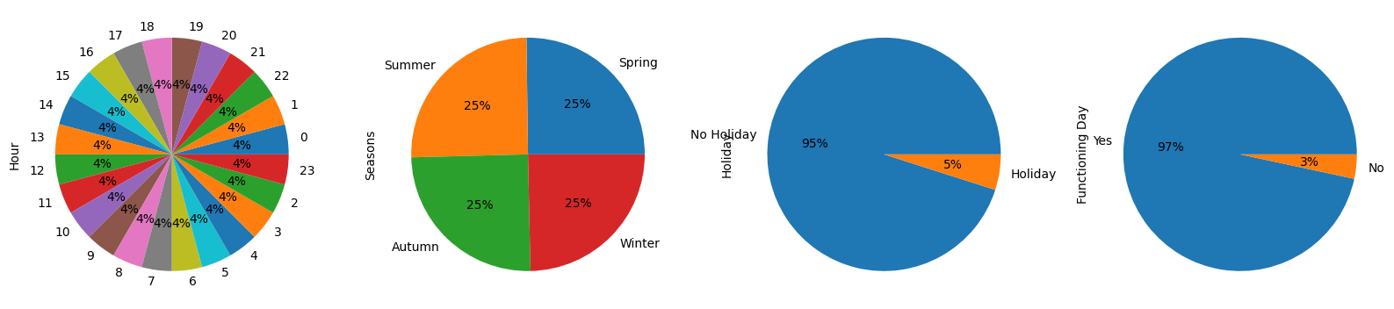
EDA
1. Seasons has approximately equally distributed data for all categories(Spring-2208, Summer-2208, Autumn-2184, Winter-2160)
2. Hour has exactly equally distributed data for all categories
3. Holiday and Functional Day has unequal data distribution in the categories

Slide 6
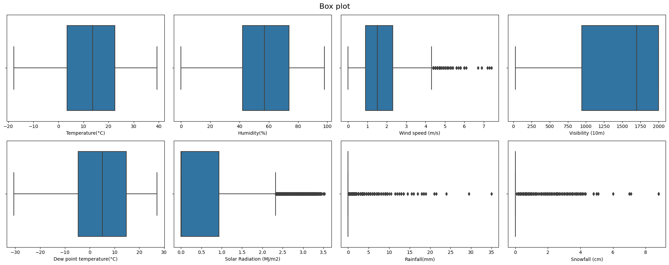
Box Plot
We can conclude here that windspeed, Solar Radiation, Rainfall, Snowfall has outliers in it, also data has skewed distribution, so used Capping & Percentile Method For outlier removal

Slide 7
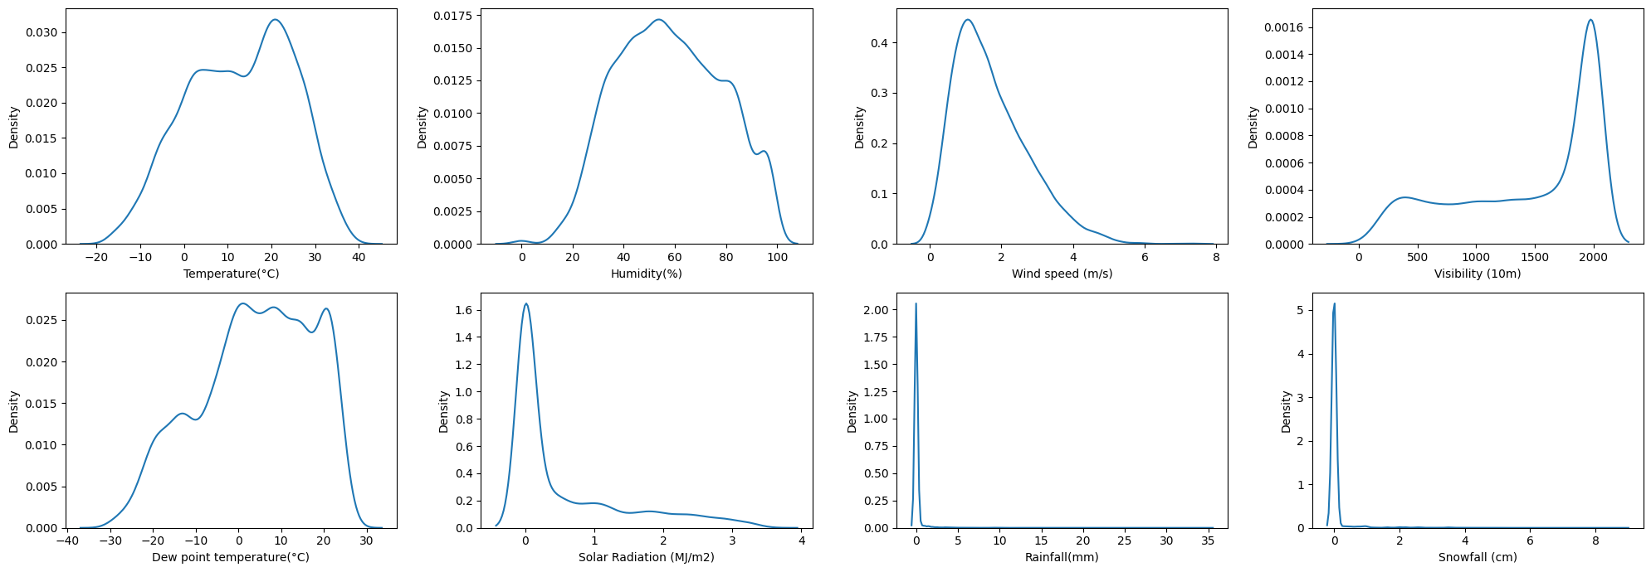
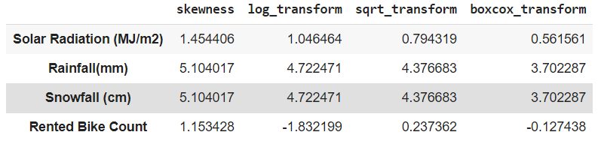
Skewness
Visibility, Solar Radiation, Rainfall and snowfall has highly skewed data
While other attributes have comparatively less skewed data

Slide 8
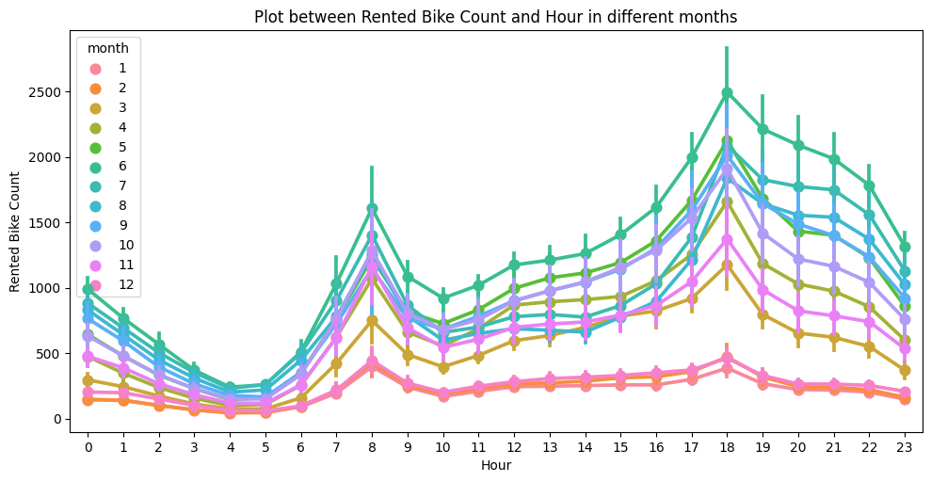
Rented Bike Count per Hour in different months
1. December, January, February has the lowest bikes rented count
2. While June has the highest bikes rented count
3. In Every month the demand for bikes peeks at 8AM and 6PM

Slide 9
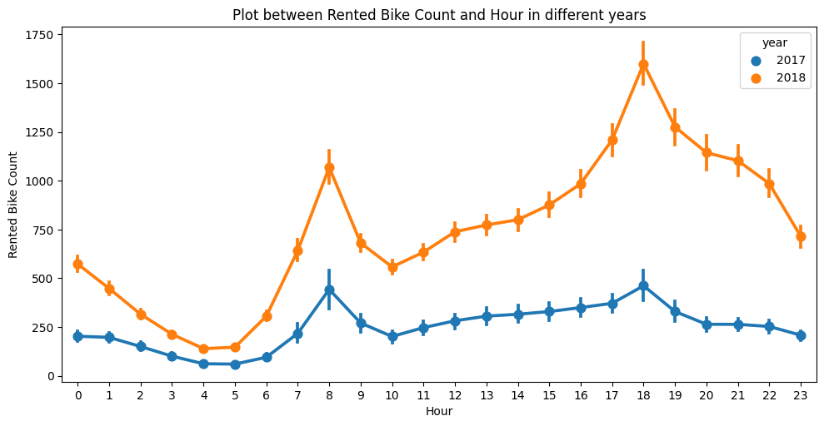
Rented Bike Count and Hour in different years
Bikes rented in an hour count increased in 2018 as compared to 2017
Although Trend remains the same i.e., the demand for bikes peeks at 8AM and 6PM

Slide 10
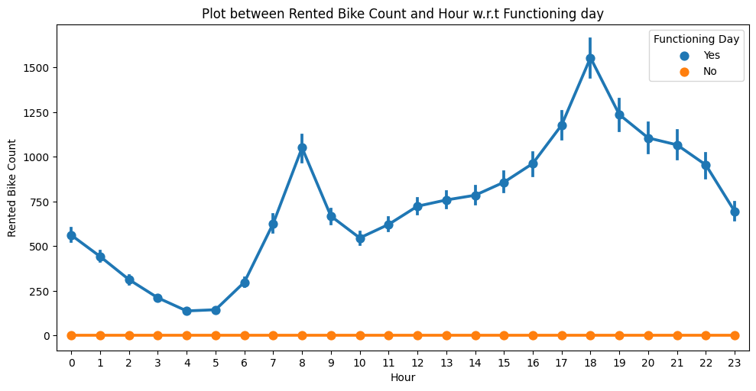
Rented Bike Count and Hour w.r.t Functioning day
Interestingly, there were absolutely zero bikes rented on Non- Functional Day
And Functional Day followed the usual Trend of peek demand at 8AM and 6PM

Slide 11
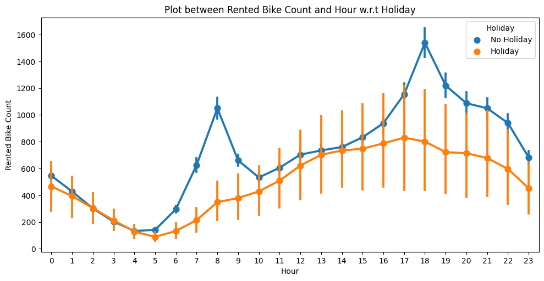
Rented Bike Count and Hour w.r.t Holiday
1. On Non-Holiday days bike rent demand increased between 7AM-9AM, then again, the demand increased from 5PM - 7PM
2. On Holiday days, bike demand was lower throughout the day as compared to Non holiday days

Slide 12
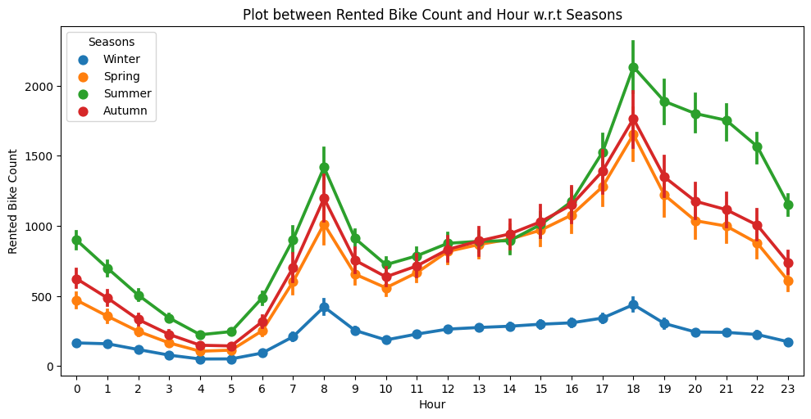
Rented Bike Count and Hour w.r.t Seasons
Summer season has the highest bike rented count
Winter season has the lowest bike rented count

Slide 13
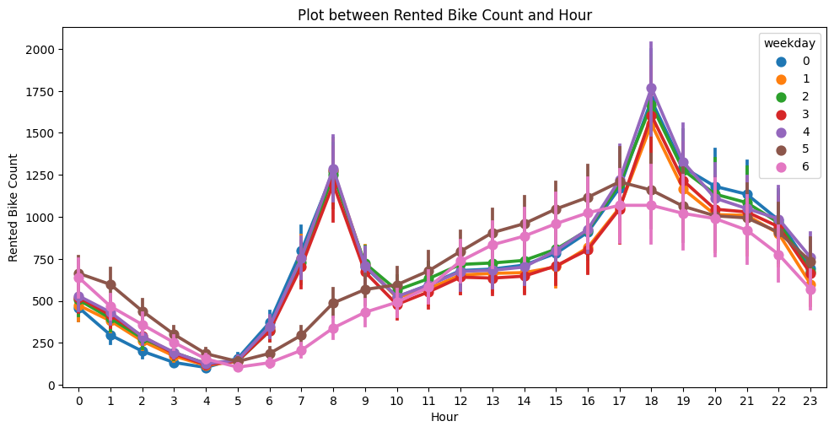
Rented Bike Count and Hour during weekdays
From Monday to Friday, the demand for bikes was high was it peaked at 8AM and 6PM
For Saturday and Sunday, the demand for bikes was low as compared to other days.

Slide 14
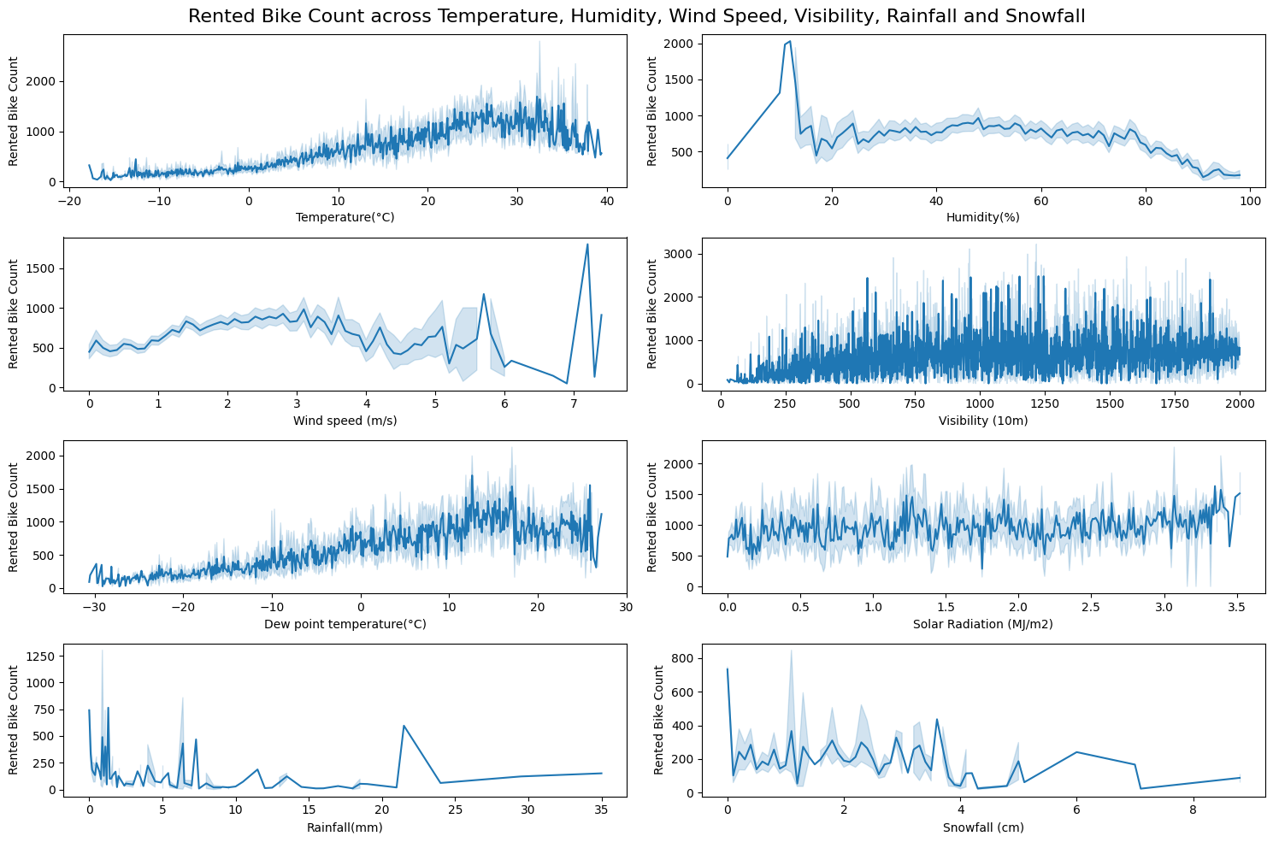
Rented Bike Count across Temperature, Humidity, Wind Speed, Visibility, Rainfall and Snowfall
As temperature increases till 30°C, rented bike count also increases, after that the rented bike count decreases gradually, similar behavior is seen in Dew point temperature
Till 10% humidity, the rented bike count is steeply increased, but after that the count has fallen drastically
Visibility, Solar radiation doesn't reflect any direct relation with rented bike count
Highest number of rented bike count can be seen when the Snowfall is zero, but it drastically decreases as the snowfall starts
Also, sudden increase in rented bike can be seen when the wind speed is ~7m/s

Slide 15
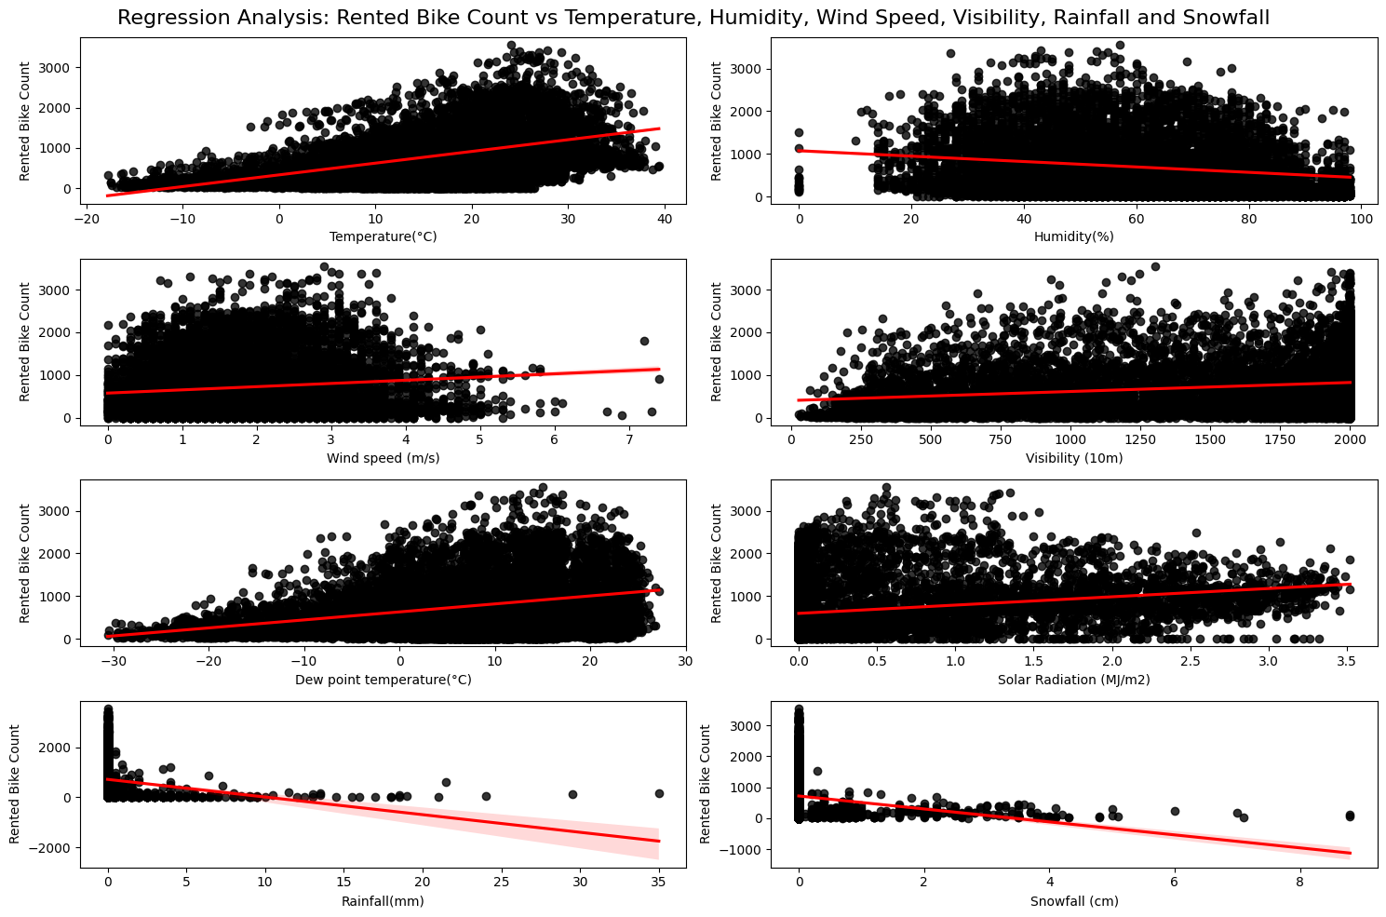
Regression Analysis: Rented Bike Count vs Temperature, Humidity, Wind Speed, Visibility, Rainfall and Snowfall
Temperature(°C), Wind speed (m/s), Visibility (10m), Dew point temperature(°C), Solar Radiation (MJ/m2) have positive correlation with rented bike count
Humidity(%), Rainfall(mm), Snowfall (cm) have negative correlation with rented bike count

Slide 16
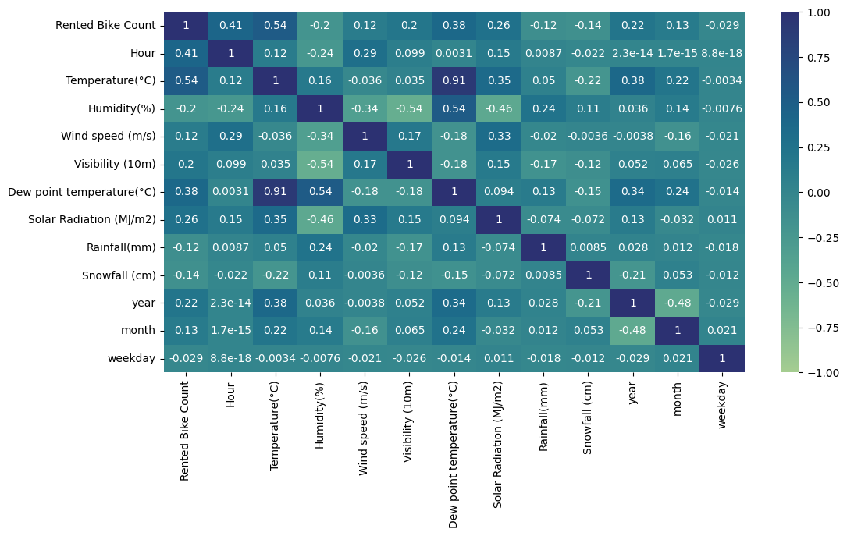
Correlation Matrix
Temperature and Dew point temperature has high Correlation between them i.e., 0.91 This will badly effect while training the model
Using VIF we can decide which column to remove between Temperature and Dew point Temperature

Slide 17
List of Algorithm Used
Linear Regression
Linear Regression with Ridge Regularization
Linear Regression with Lasso Regularization
Decision Tree Regressor
RandomForest Regressor
XGBoost Regressor

Slide 18
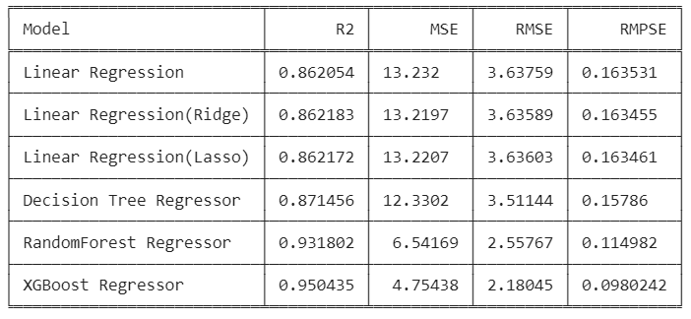
Performance Metrics of different Models

Slide 19
Conclusion
Based on the Analysis, the key findings from the exploratory data analysis (EDA) and the evaluation of the machine learning models are:
Exploratory Data Analysis (EDA):
Lowest bike rental counts were observed in December, January, and February, while June had the highest rental count.
The demand for bikes peaked at 8 AM and 6 PM every month.
On non-holiday days, the bike rental demand increased between 7 AM - 9 AM and 5 PM - 7 PM.
On holiday days, the bike demand was lower throughout the day compared to non-holiday days.
The summer season had the highest bike rental count, while winter had the lowest count.
As the temperature increased up to 30°C, the rented bike count also increased, but after that point, the count decreased.
Modeling and Evaluation:
Six machine learning algorithms were used: Linear Regression, Linear Regression with Ridge Regularization, Linear Regression with Lasso Regularization, Decision Tree Regressor, Random Forest Regressor, and XGBoost Regressor.
Evaluation of the models on the training set showed that XGBoost Regressor had the lowest Mean Squared Error (MSE), Root Mean Squared Error (RMSE), and Relative Mean Squared Percentage Error (RMPSE), as well as the highest R2 score.
Linear Regression, Linear Regression with Ridge Regularization, and Linear Regression with Lasso Regularization models had similar R2, MSE, RMSE, and RMPSE scores.
Linear Regression had the highest MSE, RMSE, and RMPSE scores.
Also, dataset did not exhibit overfitting.
Overall, the XGBoost Regressor performed the best among the evaluated models, showing the lowest errors and the highest R2 score.

